Slide 1
DYNAMIC PROGRAMMING:
Matrix Chain Multiplication

Slide 2
Dynamic Programming
A generalization of iteration and recursion.
“Dynamic Programming is recursion’s somewhat neglected cousin. …(It) is the basis of comparison and alignment routines.
Bottom-up design:
  Start at the bottom
  Solve small sub-problems
  Store solutions
  Reuse previous results for solving larger sub-problems

Slide 3
Dynamic Programming vs. Recursion and Divide & Conquer
In a recursive program, a problem of size n is solved by first solving a sub-problem of size n-1.
In a divide & conquer program, you solve a problem of size n by first solving a sub-problem of size k and another of size k-1, where 1 < k < n.
In dynamic programming, you solve a problem of size n by first solving all sub-problems of all sizes k, where k < n.

Slide 4
Matrix Chain Multiplication
Given : a chain of matrices {A₁,A₂,…,A_{n}}.
Given the dimension of a sequence of matrices in an array arr[], where the dimension of the ith matrix is (arr[i-1] * arr[i]), the task is to find the most efficient way to multiply these matrices together such that the total number of element multiplications is minimum.
Input: arr[] = {1, 2, 3, 4, 3}
Output: 30
Explanation: There are 4 matrices of dimensions 1×2, 2×3, 3×4, 4×3.
Let the input 4 matrices be A, B, C and D.
The minimum number of multiplications are obtained by
putting parenthesis in following way ((AB)C)D.
The minimum number is 1*2*3 + 1*3*4 + 1*4*3 = 30

Slide 5
Matrix Chain Multiplication cont.
For example, if the chain of matrices is {A, B, C, D}, the product A, B, C, D can be fully parenthesized in 5 distinct ways:
    (A ( B ( C D ))),
    (A (( B C ) D )),
    ((A B ) ( C D )),
    ((A ( B C )) D),
    ((( A B ) C ) D ).
The way the chain is parenthesized can have a dramatic impact on the cost of evaluating the product.

Slide 6
Matrix Chain Multiplication Optimal Parenthesization
Example: A[30][35], B[35][15], C[15][5]
minimum of A*B*C
A*(B*C) = 30*35*5 + 35*15*5 = 7,585
(A*B)*C = 30*35*15 + 30*15*5 = 18,000
How to optimize:
  Brute force – look at every possible way to parenthesize : Ω(4^{n}/n^{3/2})
  Dynamic programming – time complexity of Ω(n³) and space complexity of Θ(n²).

Slide 7
Dynamic Programming : Two Properties
1) Optimal Substructure: In the above case, we are breaking the bigger groups into smaller subgroups and solving them to finally find the minimum number of multiplications. Therefore, it can be said that the problem has optimal substructure property.
2) Overlapping Subproblems: We can see in the recursion tree that the same subproblems are called again and again and this problem has the Overlapping Subproblems property.
Matrix Chain Multiplication problem has both properties of a dynamic programming problem.

Slide 8
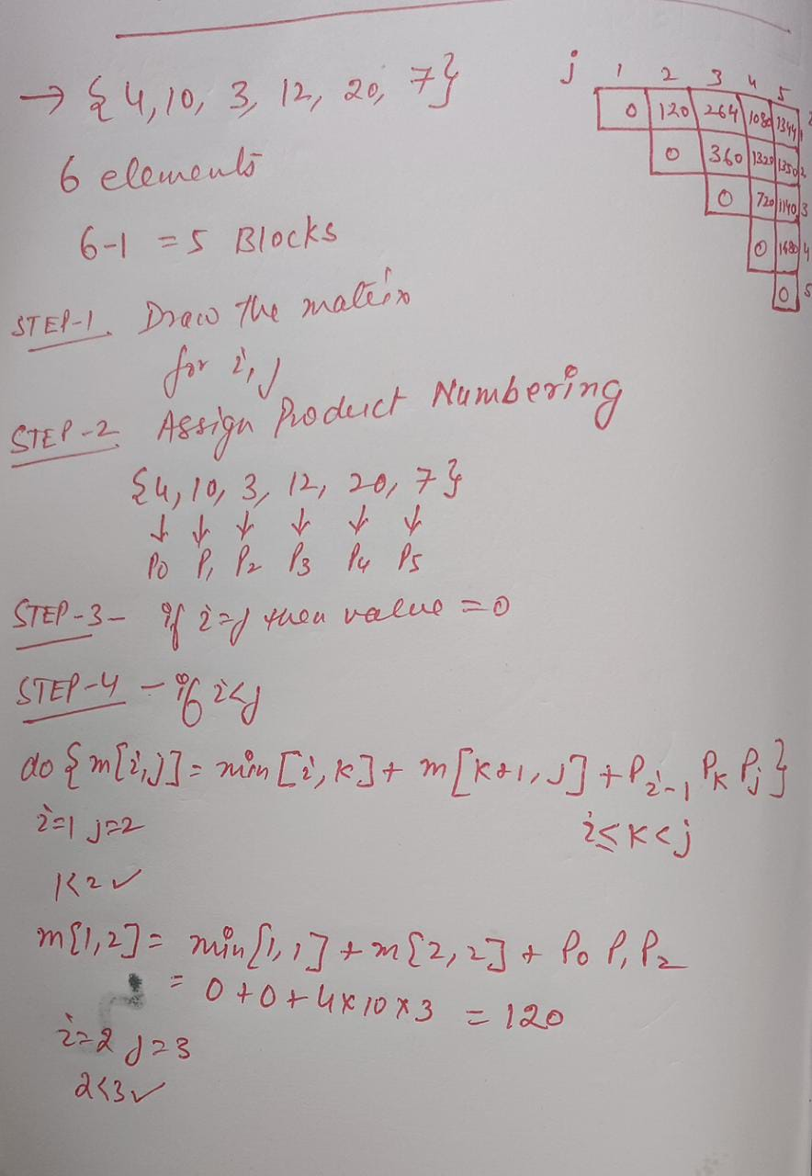
MATRIX CHAIN MULTIPLICATION

Slide 9
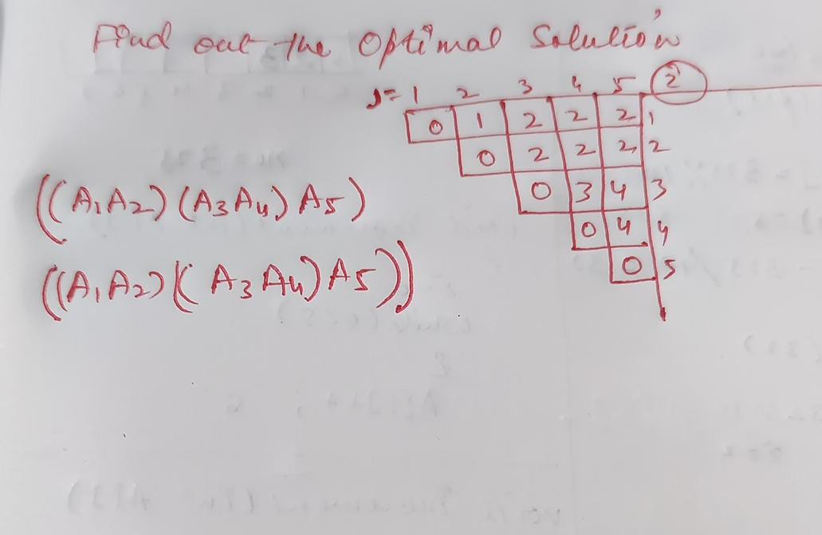
MATRIX CHAIN MULTIPLICATION

